Slide 1




CHANGING THE GAME IN
ADOLESCENT-CENTERED DESIGN:
ASSETS, ACCESS, ADHERENCE
#changingthegame #AIDS2108
Please tag @grassrootsoccer

Slide 2
Leveraging Private Sector Partnerships to Increase Uptake of Testing and Treatment for Adolescent Boys and Young Men
Lauren Marks| July 22, 2018

Slide 3
More than ½ of men
This is fueling the epidemic in the 15-24 year old women
under age 35
do not know their status and are not on treatment

Slide 4
Fewer men seek HIV testing
Progress Toward First 95 by Sex
Country | Female (%) | Male (%)
Lesotho | 82 | 71
Malawi | 76 | 67
Swaziland | 89 | 78
Zambia | 77 | 70
Zimbabwe | 70 | 63
Sources: UNAIDS 90-90-90 Progress report, *PHIA fact sheet, ** SDS (Denominator = All PLHIV)

Slide 5
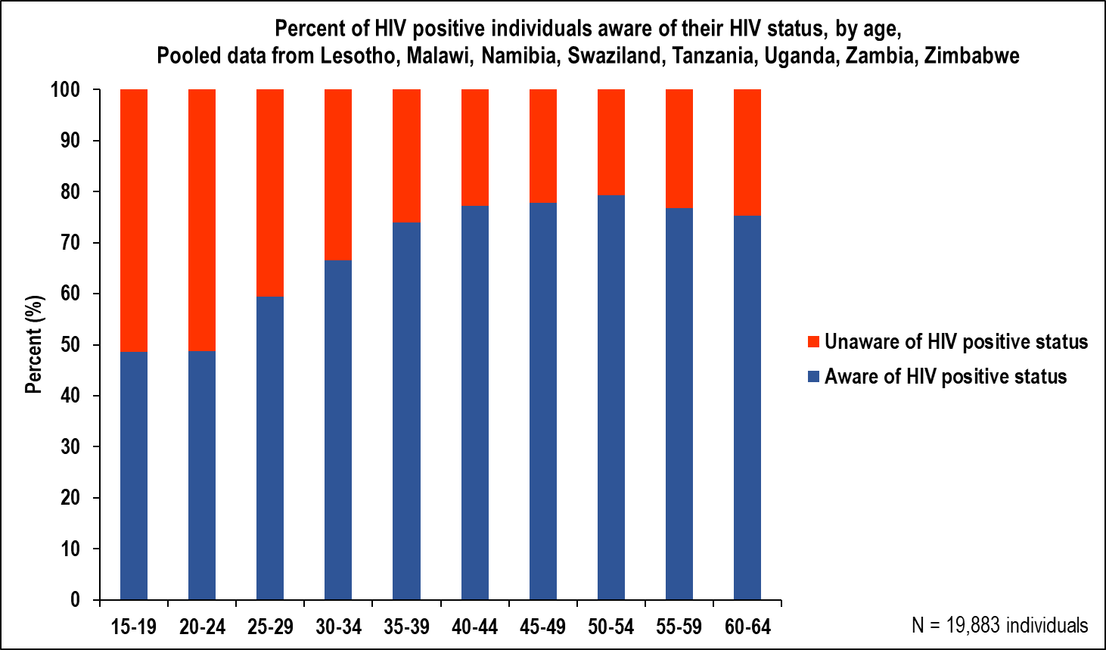

Fewer young people know their status
.
The Largest Overall Gap: Awareness of HIV Positive Status by Age – Those Under 30 Often Unaware

Slide 6
Human Centered Design: Known Barriers for Access to HIV Services by Men
Masculinity
Lower Health/Treatment Literacy
Adverse clinic conditions
Confidentiality
Fear of testing positive
Fear of disclosure
Low perceived risk

Slide 7
Men who do, seek care later
Starting care late means advance illness is difficult to treat and the virus has more opportunity to spread through communities

Slide 8

The Opportunity
“We’re finding sick men, but healthy/well men at-risk of being HIV positive are the hardest to reach because they have no reason to interact with the healthcare system.” - Ambassador Deborah L. Birx, M.D.
The Unmet Need:
A deeper understanding of the barriers to men’s health seeking behavior, as well as their motivators
Targeted health promotion, services and interventions that are male centered and gender transformative
Advocacy for national, regional and global public health policies that take account of men as well as women
Partnerships that find shared public health and business value in investing in innovative initiatives to engage men in quality care services

Slide 9

A Reminder: Why Partner with the Private Sector
To enable us to develop programs that are more effective, efficient, and sustainable
To invest in innovative approaches to HIV prevention, care, and treatment while sharing risks, resources, and rewards
To harness private sector strengths and assets, in addition to competitive edge in innovation and technology

Slide 10

Adopting Private Sector Approaches
We apply private sector areas of expertise to our program, including:
Communications and public relations
Marketing
Market segmentation (especially to reach certain groups)
Sales
Research and development
Product design, development, distribution, supply chain
Market research
Brand awareness
Innovation

Slide 11
Finding & Reaching Men: The Goal
Find and reach at-risk men ages 24-35 years to increase the number of HIV+ adult men on treatment earlier in disease progression
Diagnosis: targeted testing to identify HIV positive men
For those found positive, increase the number of people on treatment

Slide 12

Public and Private Sector: Supply and Demand
DEMAND:
Will use its core competencies to develop segmented messages, branding, and an overall marketing campaign to improve the demand for healthcare services by men
SUPPLY:
Will advocate for service delivery/facility-based changes, optimized testing strategies, self-testing, and decentralized, community-based services to improve the supply of healthcare services for men
Leverage the private sector to improve DEMAND for healthcare services
Improve SUPPLY of healthcare services through PEPFAR country programming

Slide 13
Leverage a Three-Step Process for Demand Creation
  Step 1: Analyze the Problem and the Person
  Use data analytics to better understand the characteristics and behaviors of young men ages 24-35 years who are at-risk:
  Market segmentation/behavior science analysis to understand the journey for both the client (men) and the providers (underlying norms, beliefs, hopes, fears)
  Step 2: Develop Brand/Campaign Which Resonates with Target Population
  Work at the community level to gain a better understanding of what types of messages will resonate with young men (focus groups, user centered design)
  Develop messages/brand/marketing campaign, including collateral materials
  Step 3: Execute the Brand/Campaign – Mass Marketing and In-Person Marketing
Print media, digital social media, TV, radio, mobile platforms, events
Community-based influencers
Celebrities, athletes, faith based leaders, peer leaders, safe spaces

Slide 14
PEPFAR: Strategies for Finding and Reaching Men
    Targeted Testing: optimize the right mix of facility-based testing, community-based testing, and self-testing, with emphasis on:
      Index testing (reaching men through their sexual partners)
      Partner notification: contract referral, provider referral, dual referral, self-testing
    Linkage: Facilitators/Expert Clients/Male Champions
    Service Delivery/Facility-Based Changes:
      Expanded clinic hours
      Fast-track services/shorter wait times
      Male-friendly services with male staff and male friendly corners
      Improved clinic operations such as easier booking systems

Slide 15
PEPFAR: Strategies for Finding and Reaching Men (Cont’d)
Retain Men in Services:
  Decentralize services though drug dispensing/ARV pick up sites/pharmacy outlets
  Support Groups, i.e. Community Adherence and Retention Groups
  Maximize existing organizational infrastructures of faith-based health and community engagement systems

Slide 16
PEPFAR: Strategies for Finding and Reaching Men - Self Testing
HIV Self-Testing (HIVST): HIVST outside of facilities must be part of the HTS portfolio and implemented at scale in areas where less than 40% of males are aware of their status – COP 18 Guidance
By providing an opportunity for people to test themselves discreetly and conveniently in private, HIVST may reach new/first-time testers, including adult men, and likely at an earlier stage of infection.
Distribution Channels: Secondary distribution particularly effective for reaching men

Slide 17
But there are still gaps that need to be addressed
Geography – vast difference in HIV prevalence within each country; investments must continue to be targeted for impact
Populations – significant age gap in those we have reached and not reached impacting epidemic control: we have successfully reached women > 25 and men > 35
Epidemic continues unchecked in men <35 and women < 25: focused prevention and treatment interventions must continue
Testing without linking is a program failure

Slide 18

Thank You!

Slide 19
CHANGING THE GAME IN
ADOLESCENT-CENTERED DESIGN:
ASSETS, ACCESS, ADHERENCE
#changingthegame #AIDS2108
Please tag @grassrootsoccer

